Slide 1
5 Starter Questions
NAPLAN PREPARATION

Slide 2
LESSON ONE NO CALCULATORS ALLOWED
NAPLAN 5 QUESTIONS STARTER

Slide 3
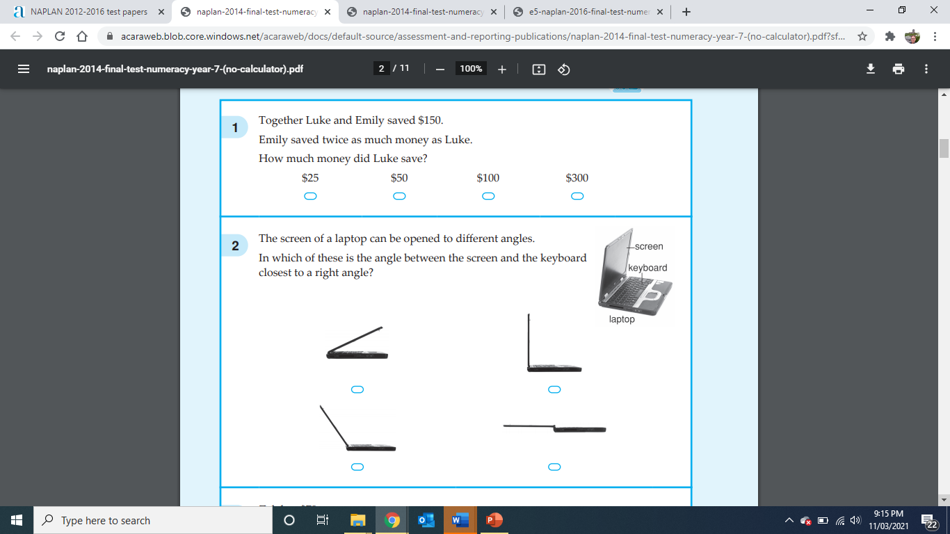
Lesson 1

Slide 4
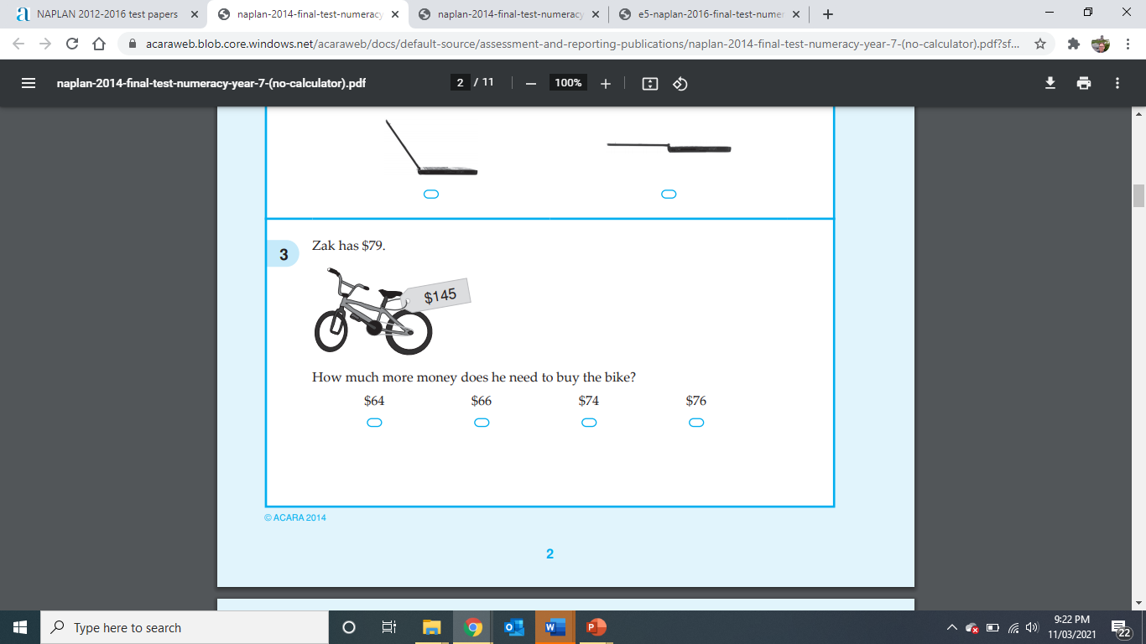
Lesson 1

Slide 5
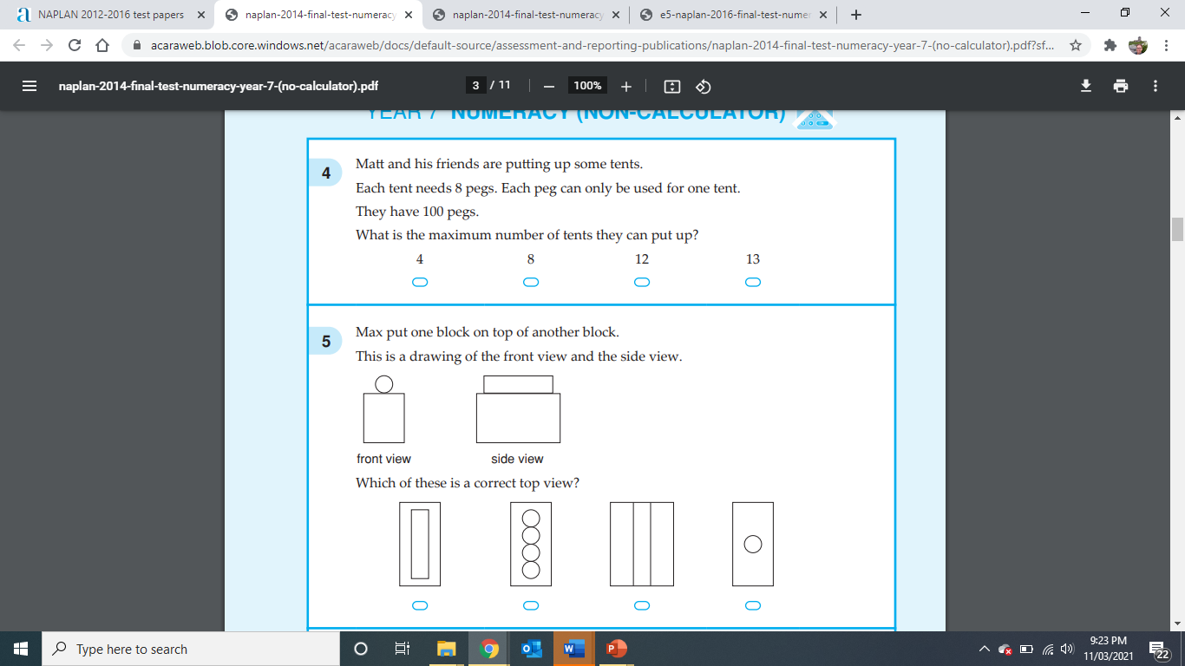
Lesson 1

Slide 6
LESSON TWO NO CALCULATORS ALLOWED
NAPLAN 5 QUESTIONS STARTER

Slide 7
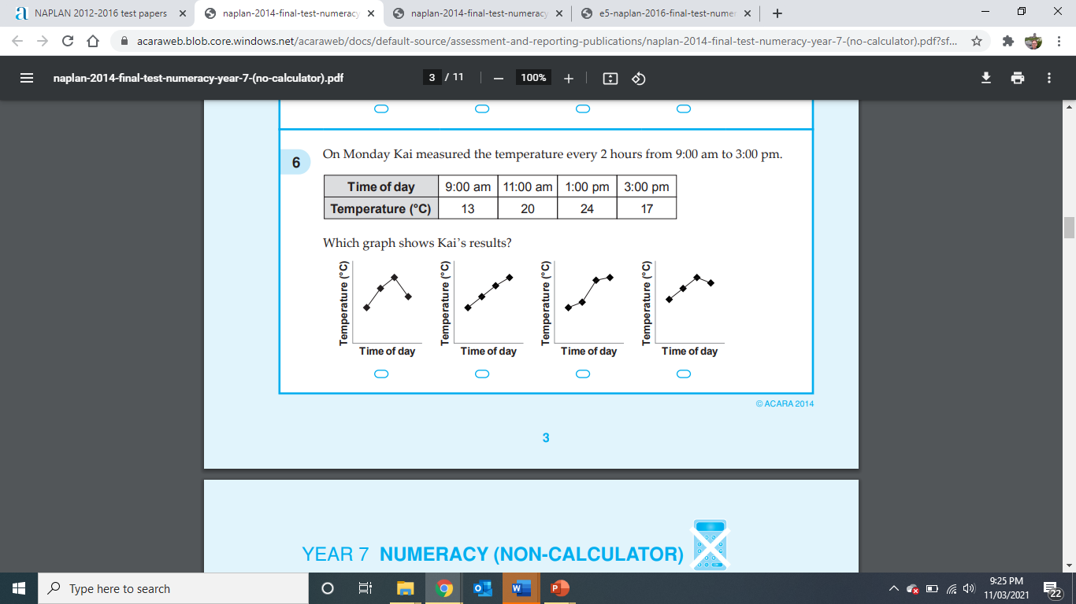
Lesson 2

Slide 8
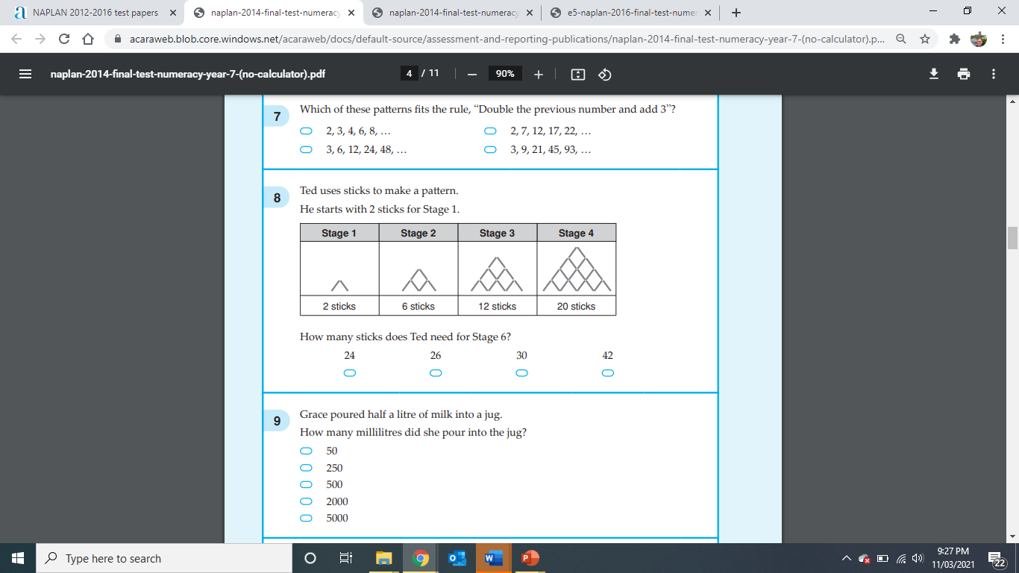
Lesson 2

Slide 9
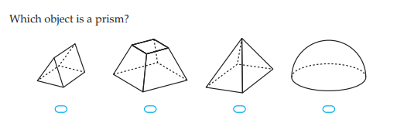
Lesson 2

Slide 10
LESSON THREE NO CALCULATORS ALLOWED
NAPLAN 5 QUESTIONS STARTER

Slide 11
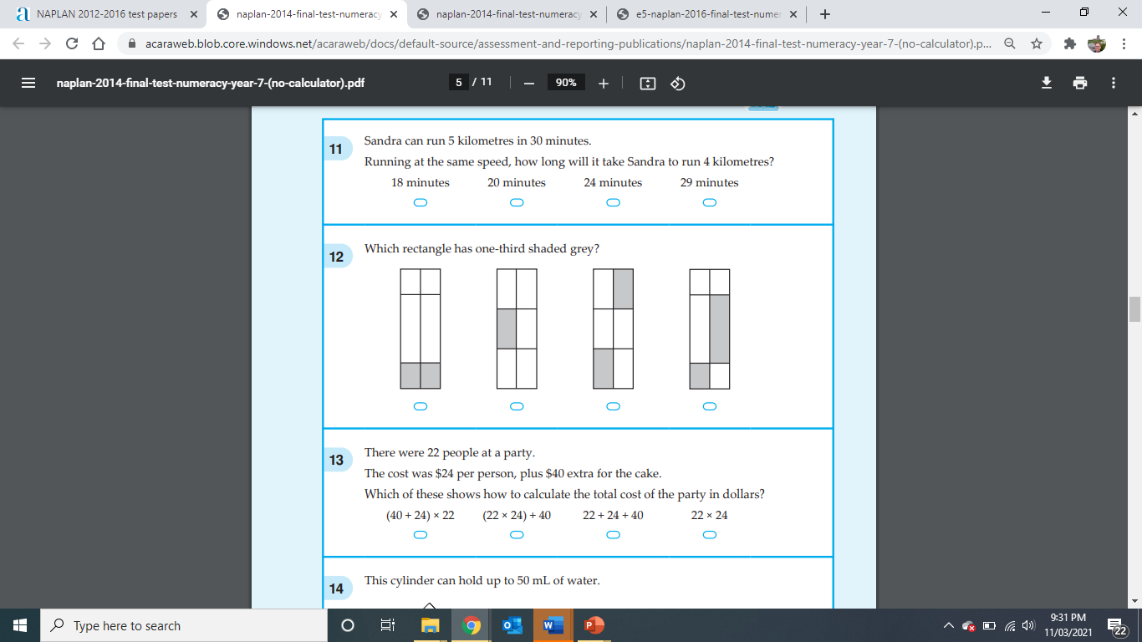
Lesson 3

Slide 12
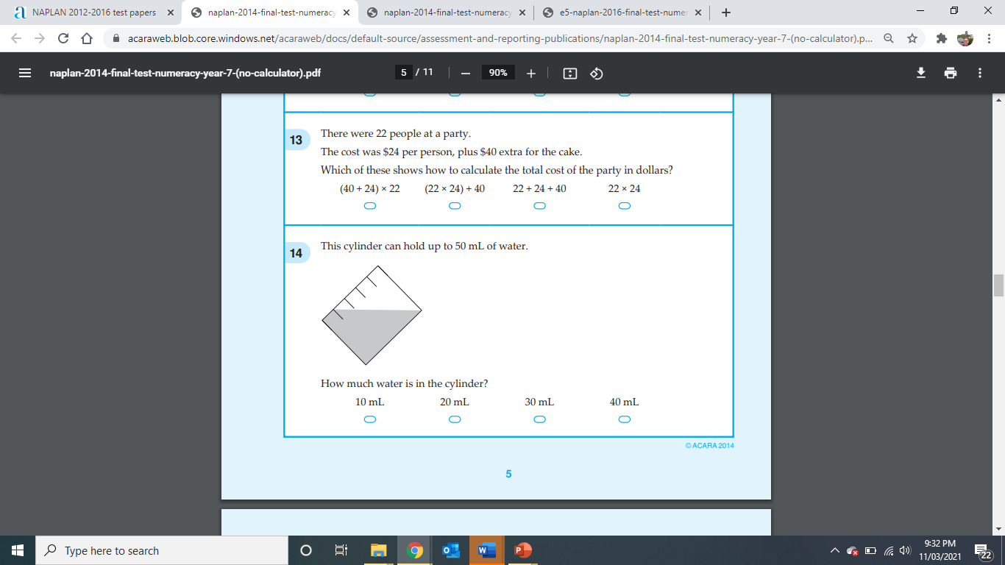
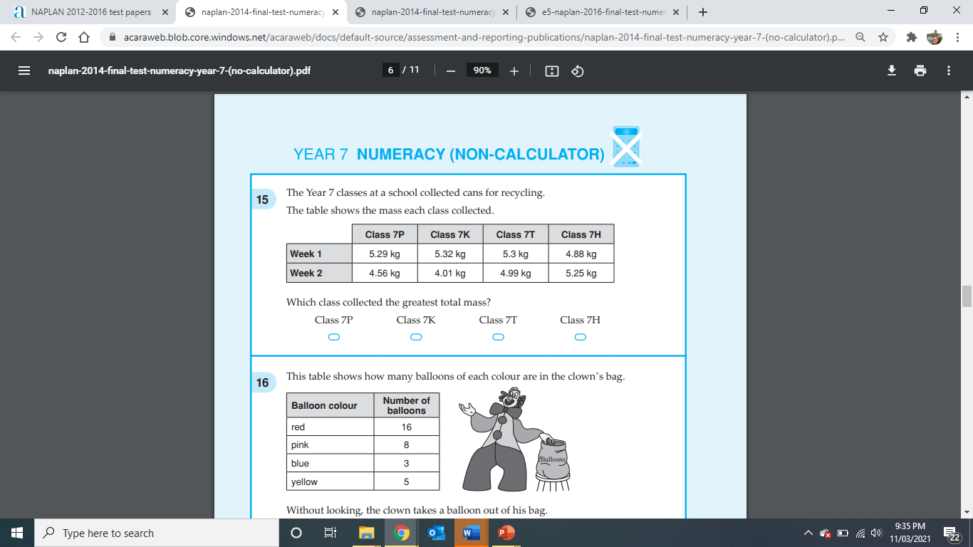
Lesson 3

Slide 13
LESSON FOUR NO CALCULATORS ALLOWED
NAPLAN 5 QUESTIONS STARTER

Slide 14
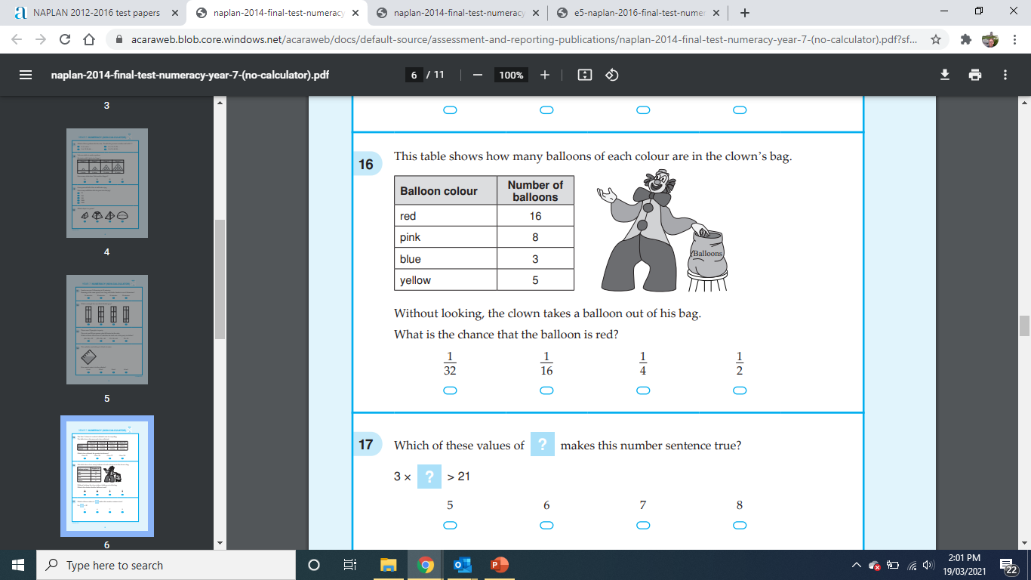
Lesson 4

Slide 15
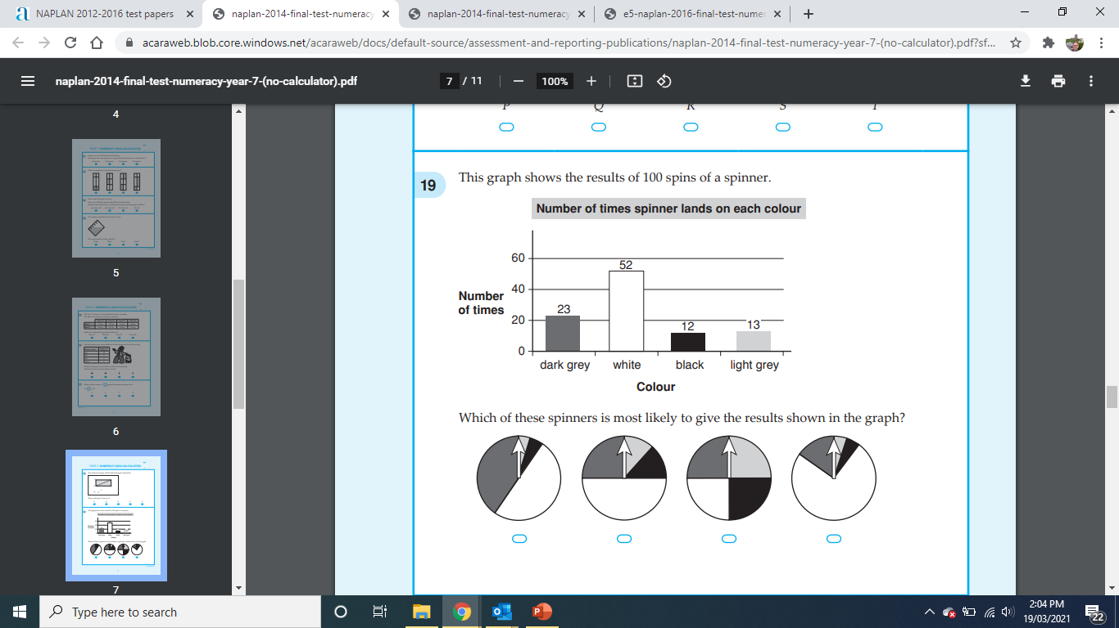
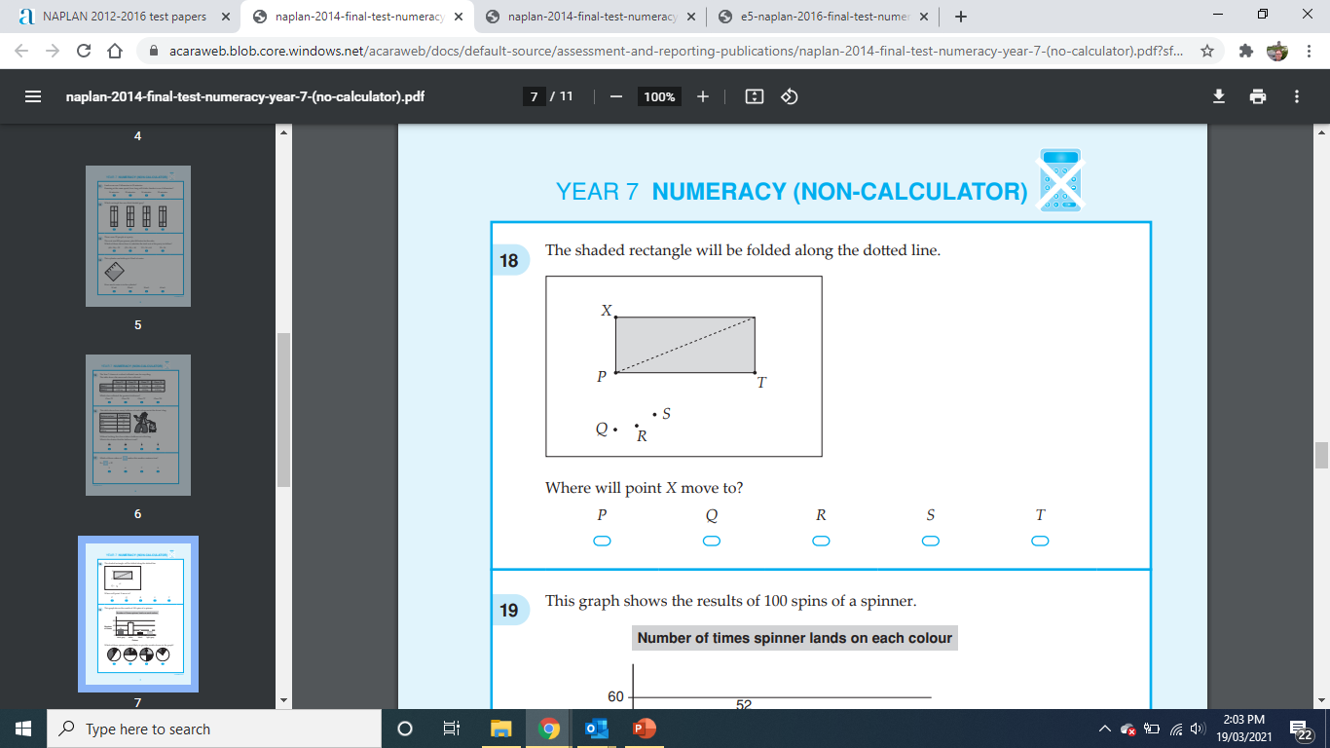
Lesson 4

Slide 16
LESSON FIVE NO CALCULATORS ALLOWED
NAPLAN 5 QUESTIONS STARTER

Slide 17
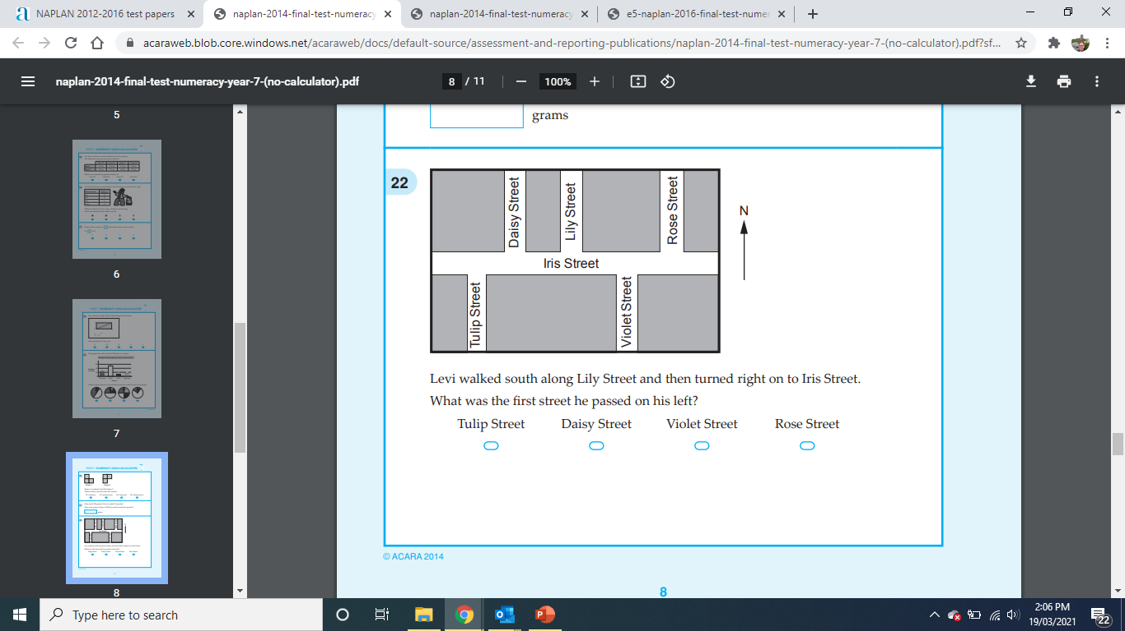
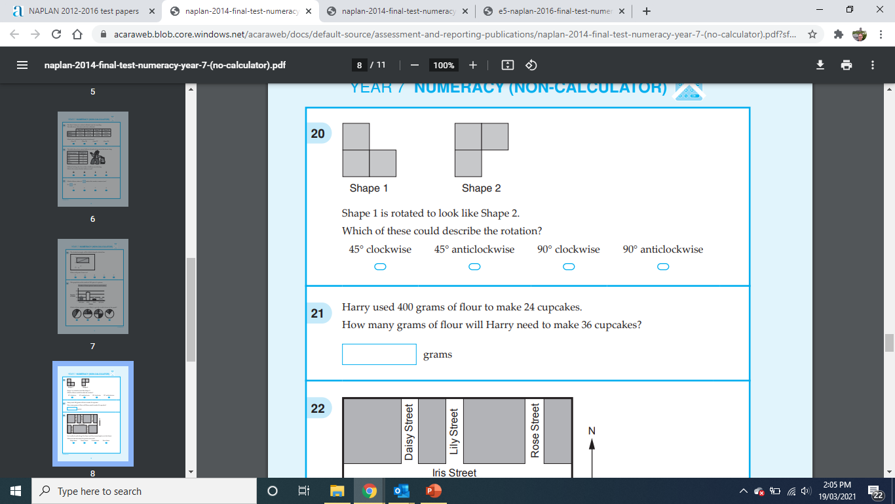
Lesson 5

Slide 18
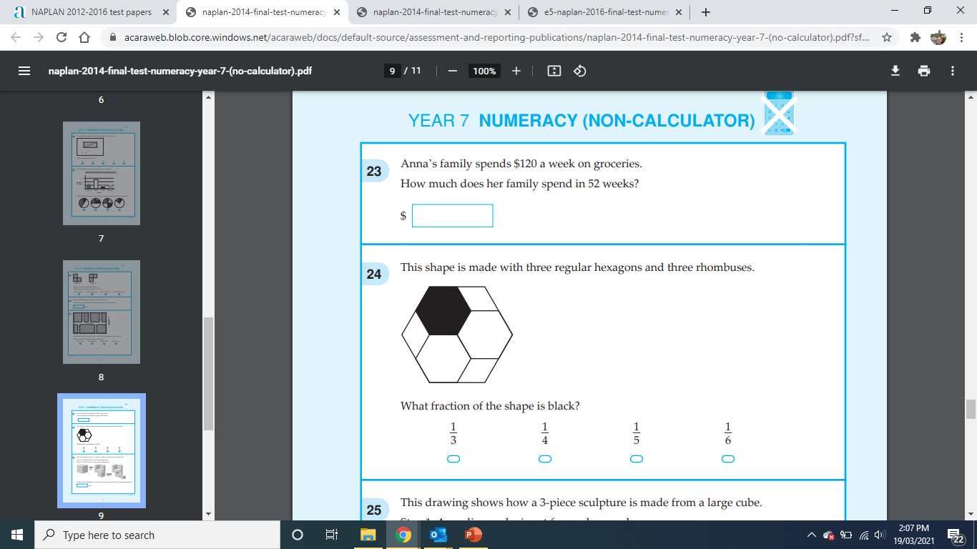
Lesson 5

Slide 19
LESSON SIX NO CALCULATORS ALLOWED
NAPLAN 5 QUESTIONS STARTER

Slide 20
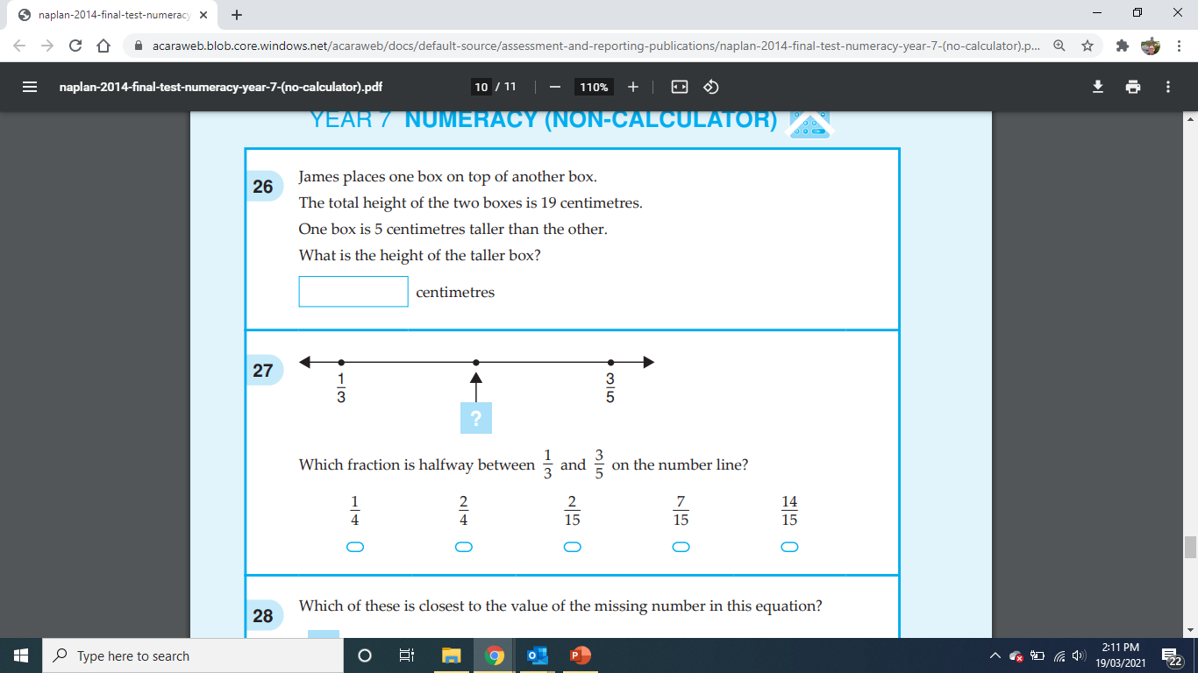
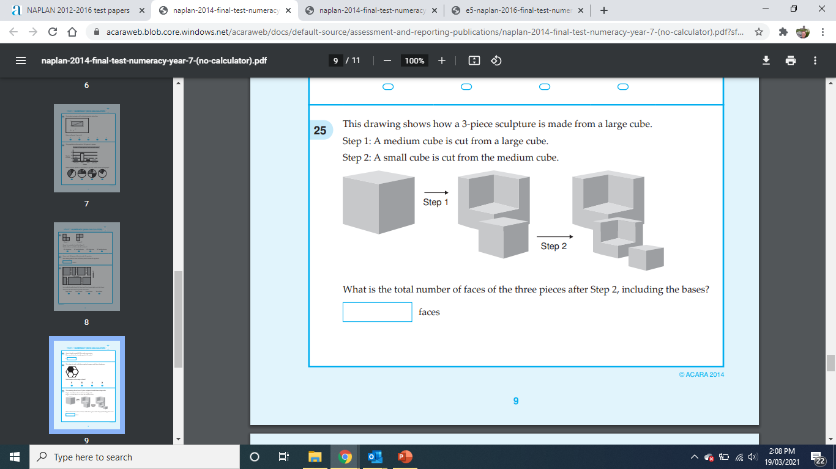
Lesson 6

Slide 21
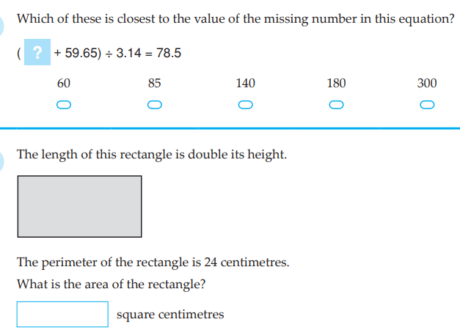
Lesson 6

Slide 22
LESSON SEVEN – CALCULATORS ALLOWED
NAPLAN 5 QUESTIONS STARTER

Slide 23
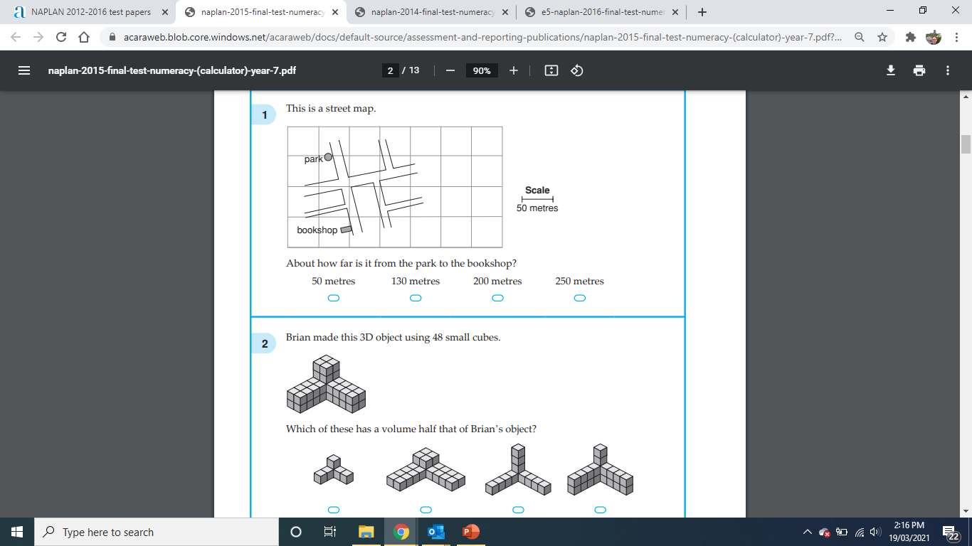
Lesson 7

Slide 24
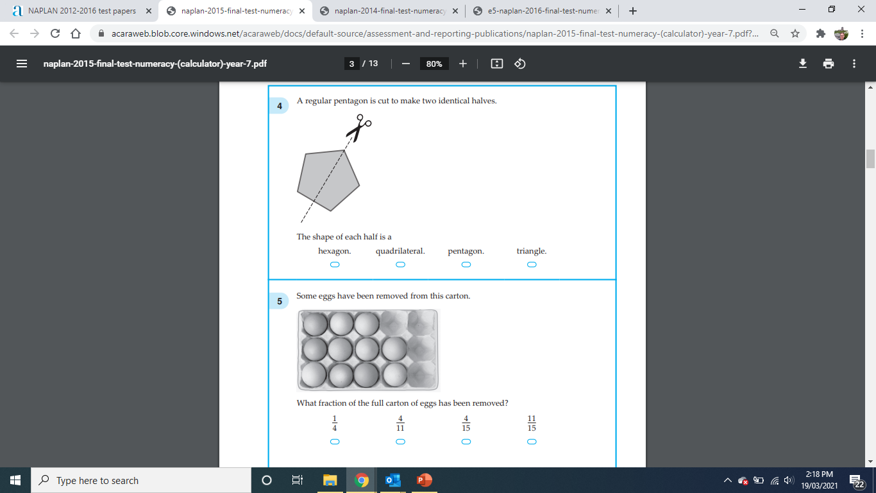
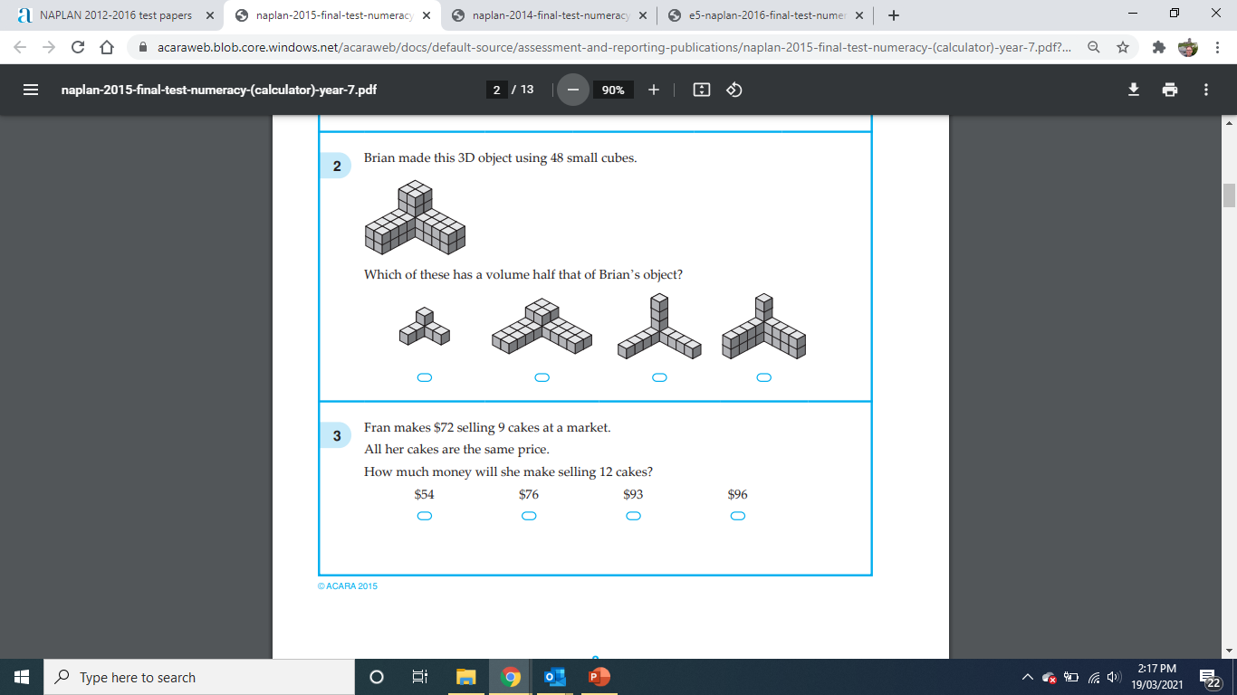
Lesson 7

Slide 25
LESSON EIGHT – CALCULATORS ALLOWED
NAPLAN 5 QUESTIONS STARTER

Slide 26
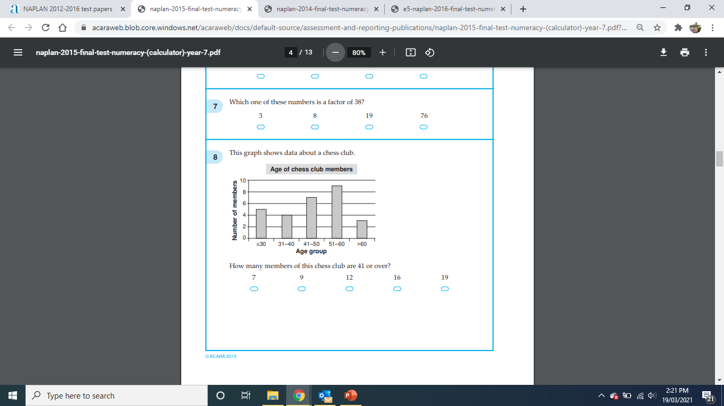
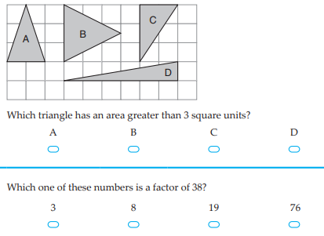
Lesson 8

Slide 27
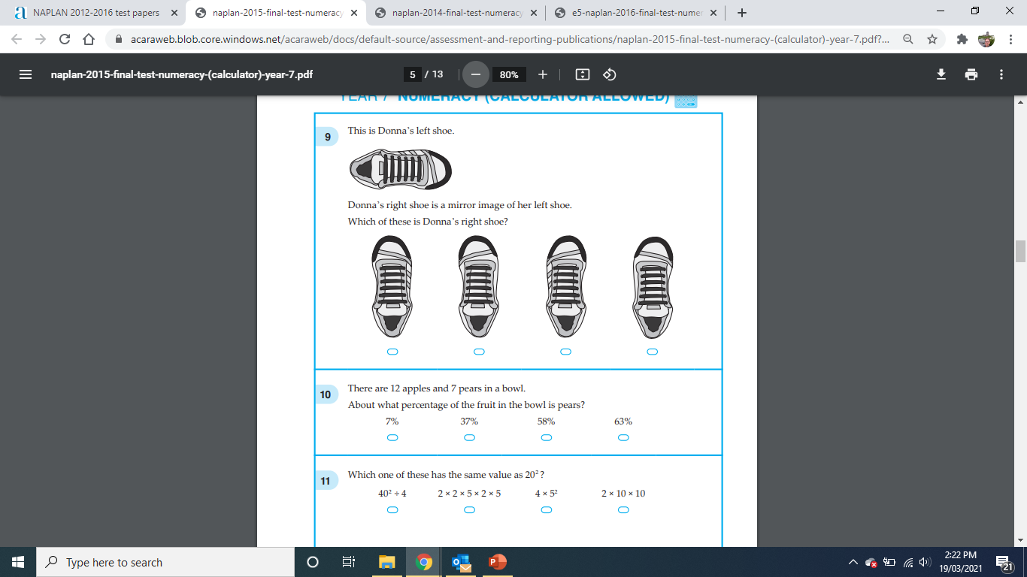
Lesson 8

Slide 28
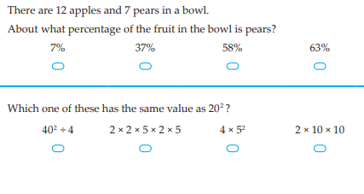
LESSON NINE – CALCULATORS ALLOWED

Slide 29
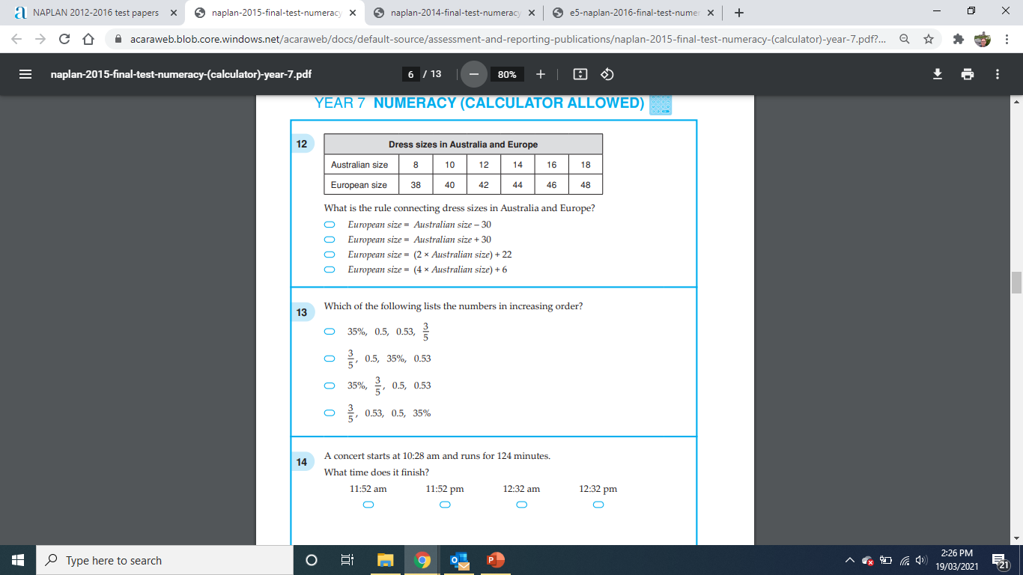
Lesson 9

Slide 30
Lesson 9

Slide 31
LESSON TEN – CALCULATORS ALLOWED
NAPLAN 5 QUESTIONS STARTER

Slide 32
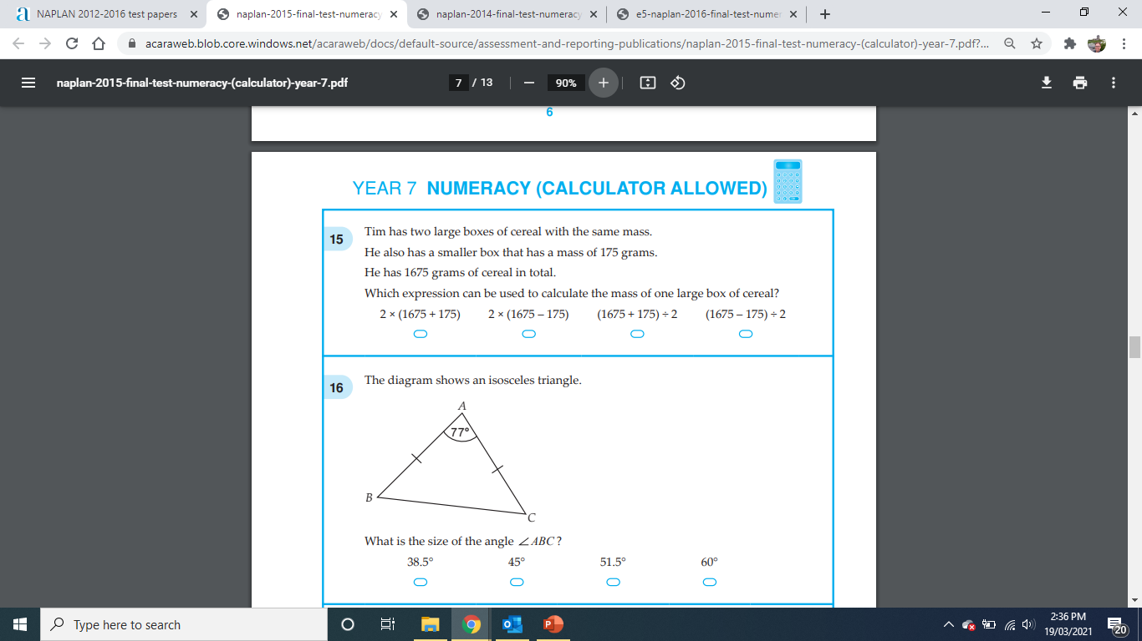
Lesson 10

Slide 33
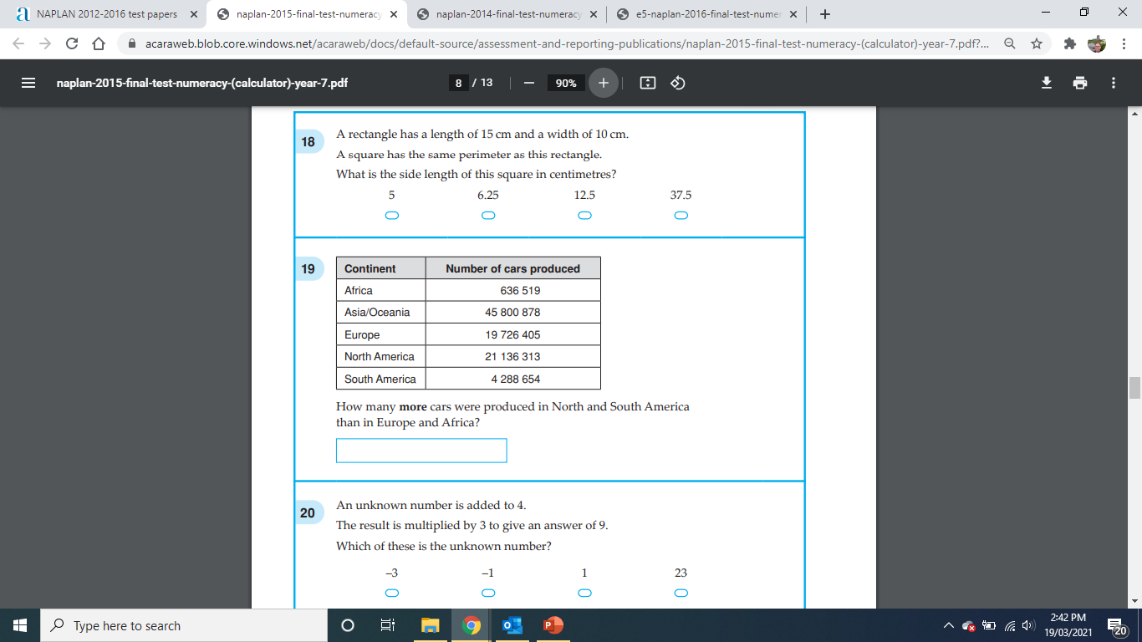
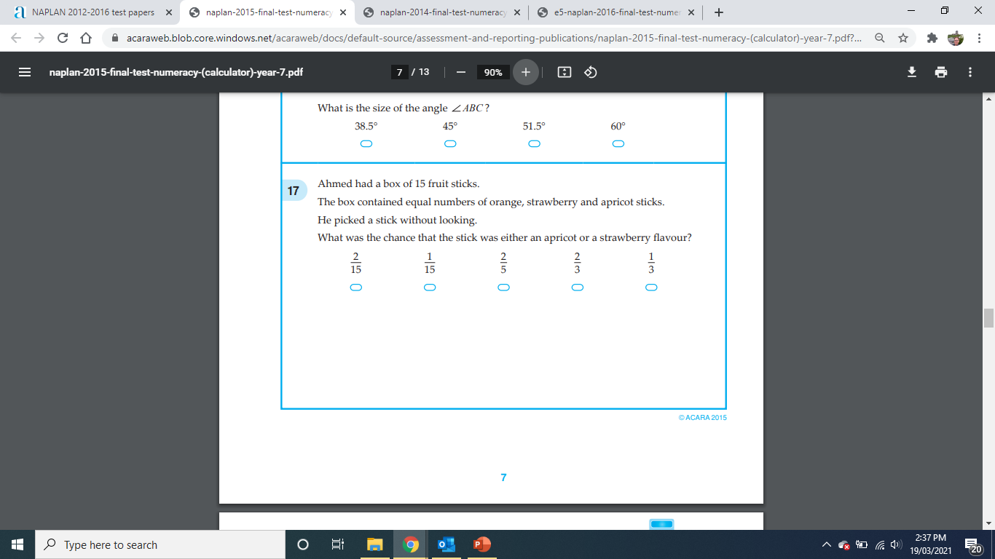
Lesson 10

Slide 34
LESSON ELEVEN – CALCULATORS ALLOWED
NAPLAN 5 QUESTIONS STARTER

Slide 35
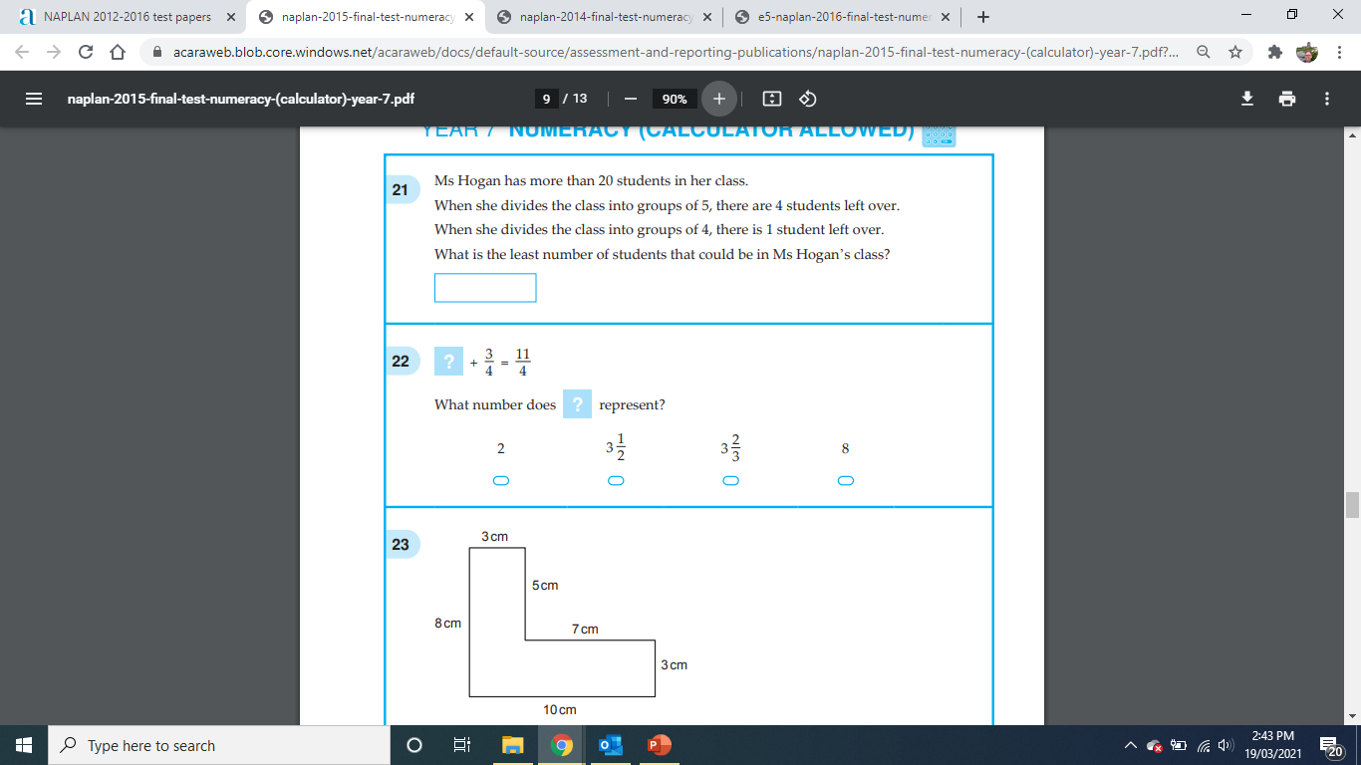
Lesson 11

Slide 36
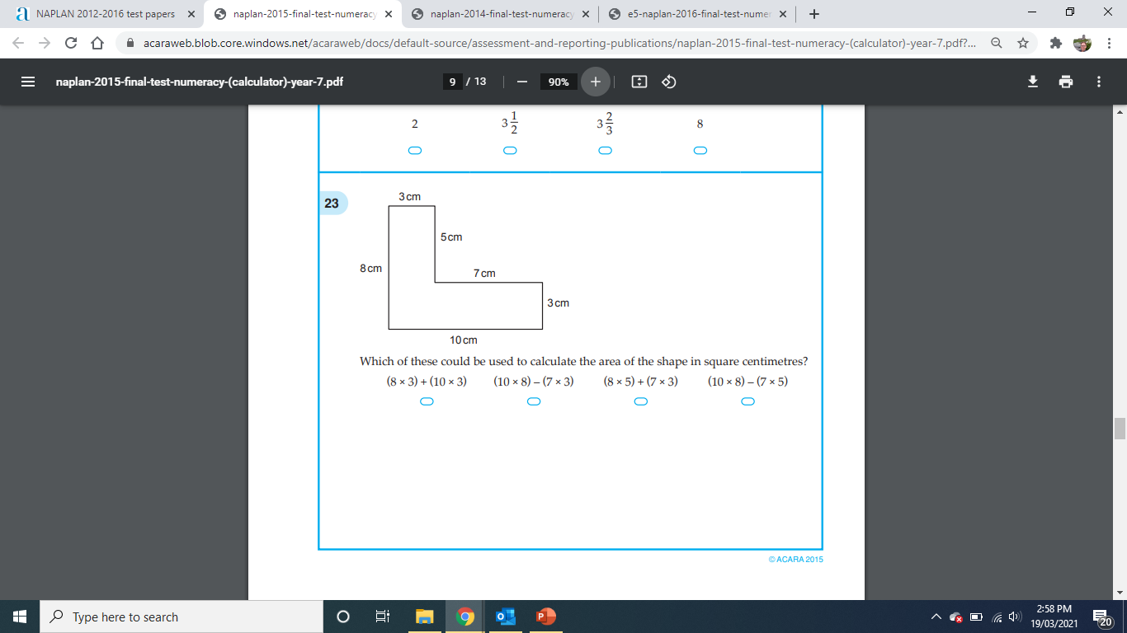
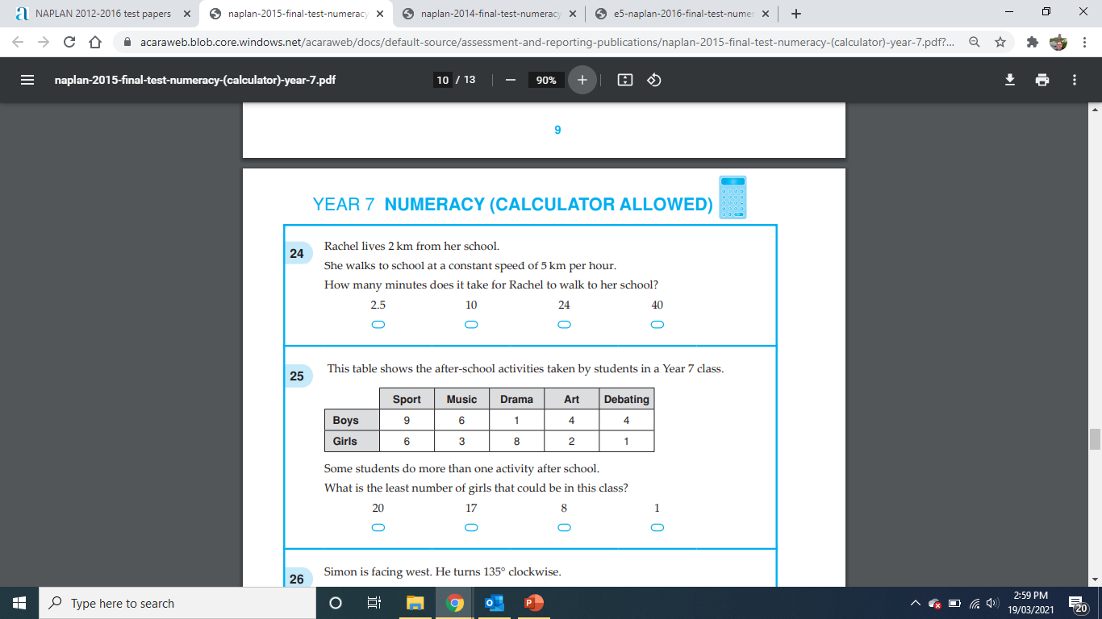
Lesson 11

Slide 37
LESSON TWELVE – CALCULATORS ALLOWED
NAPLAN 5 QUESTIONS STARTER

Slide 38
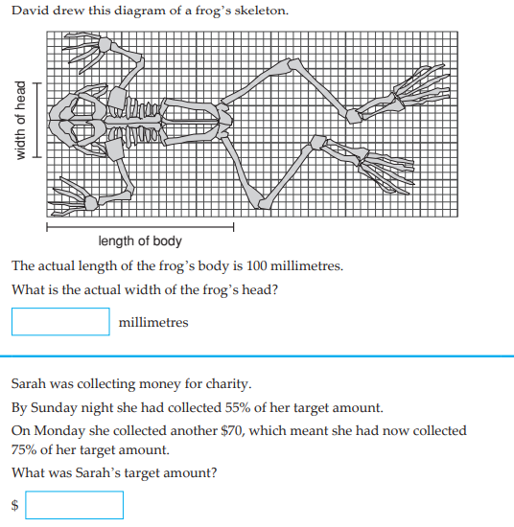
Lesson 12

Slide 39
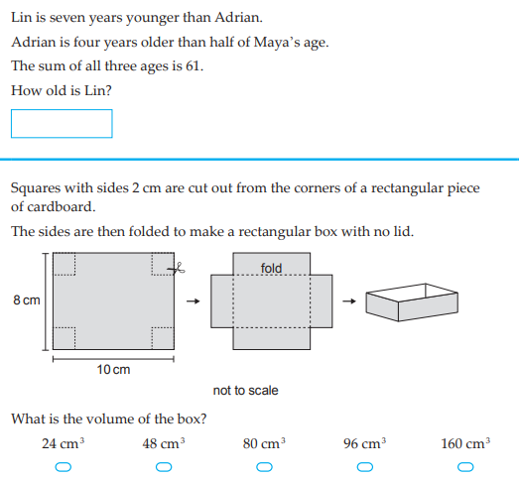
Lesson 12

Slide 40
LESSON THIRTEEN – NO CALCULATORS ALLOWED
NAPLAN 5 QUESTIONS STARTER

Slide 41
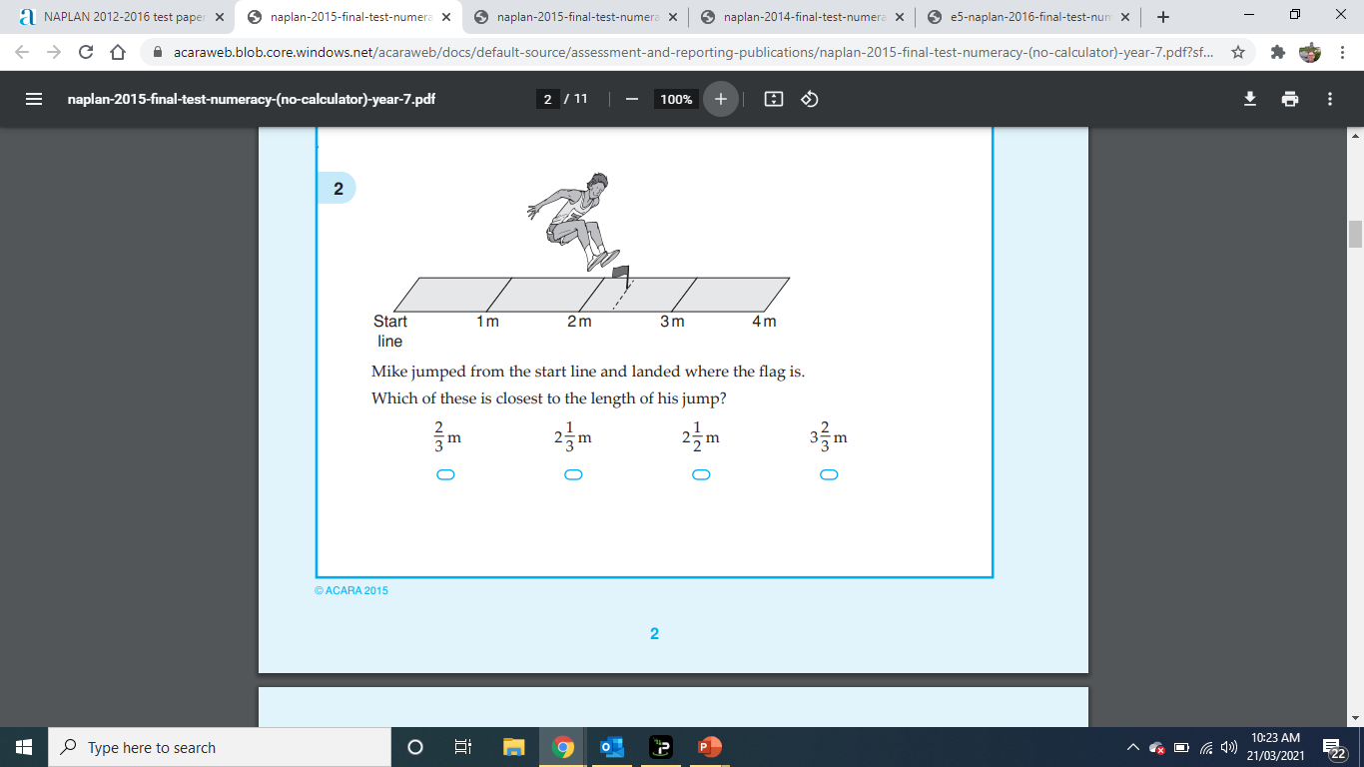
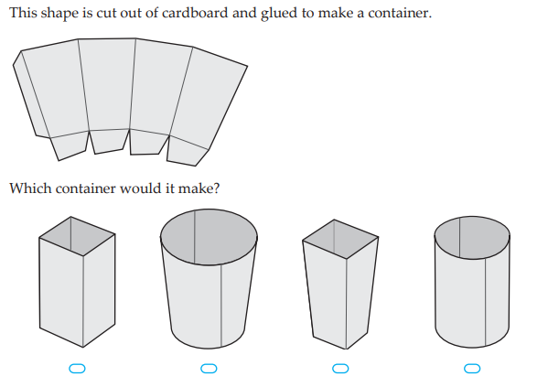
Lesson 13

Slide 42
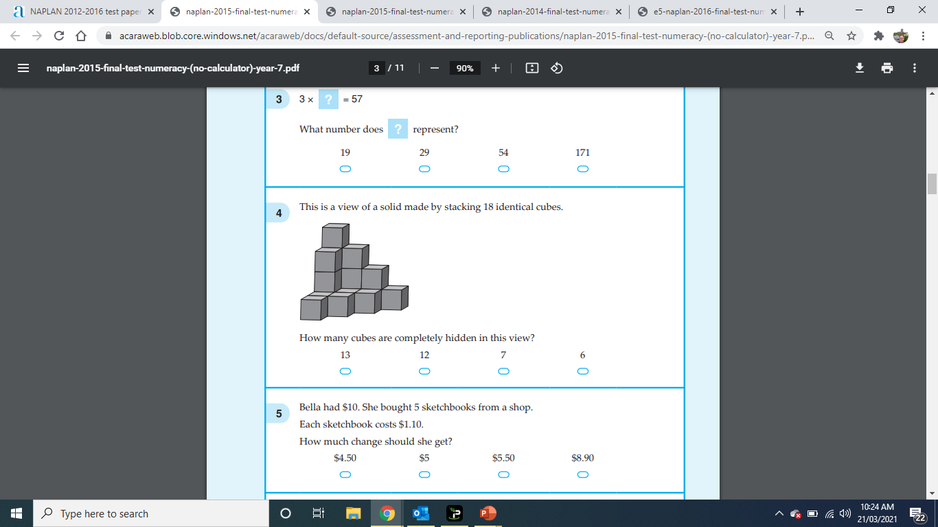
Lesson 13

Slide 43
LESSON FOURTEEN NO CALCULATORS ALLOWED
NAPLAN 5 QUESTIONS STARTER

Slide 44
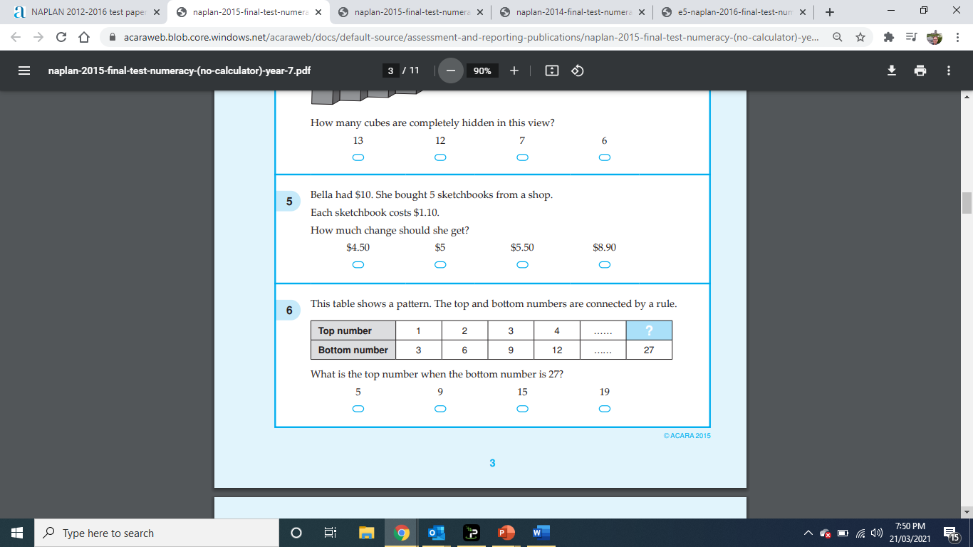
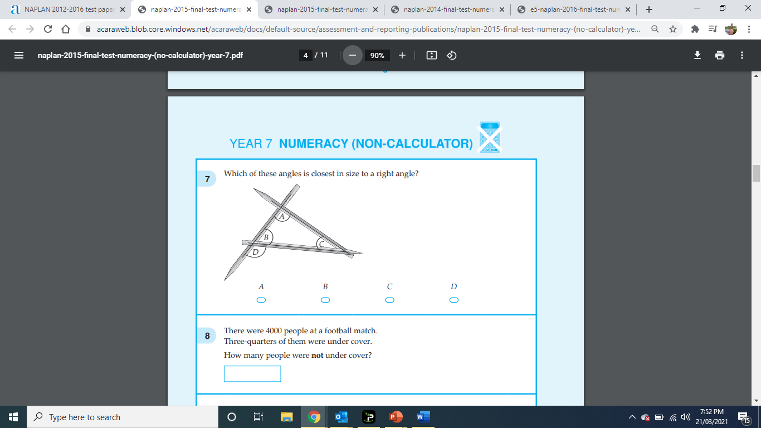
Lesson 14

Slide 45
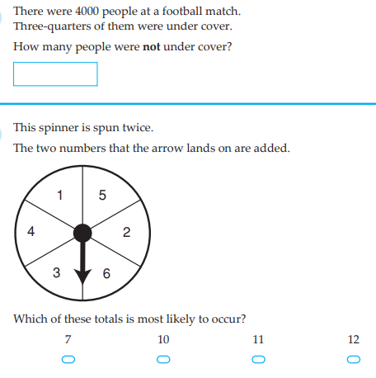
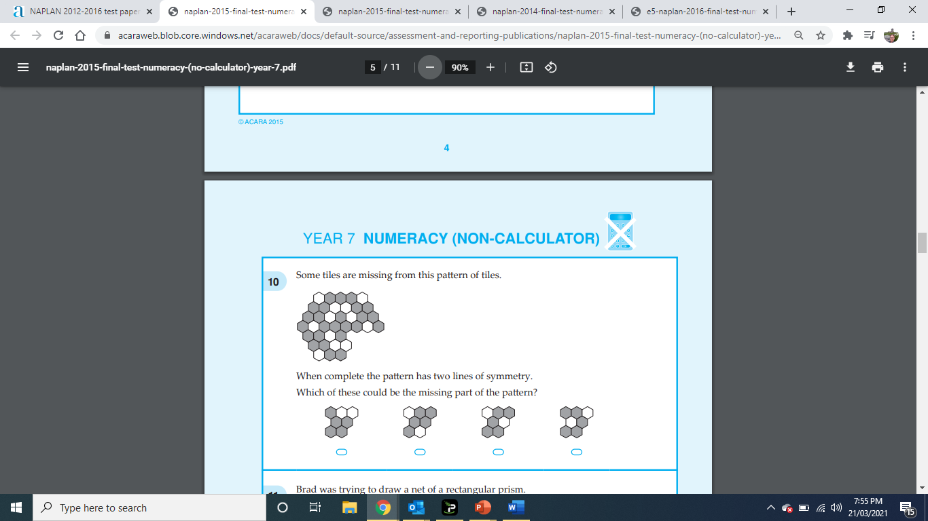
Lesson 14

Slide 46
LESSON FIFTEEN – NO CALCULATORS ALLOWED
NAPLAN 5 QUESTIONS STARTER

Slide 47
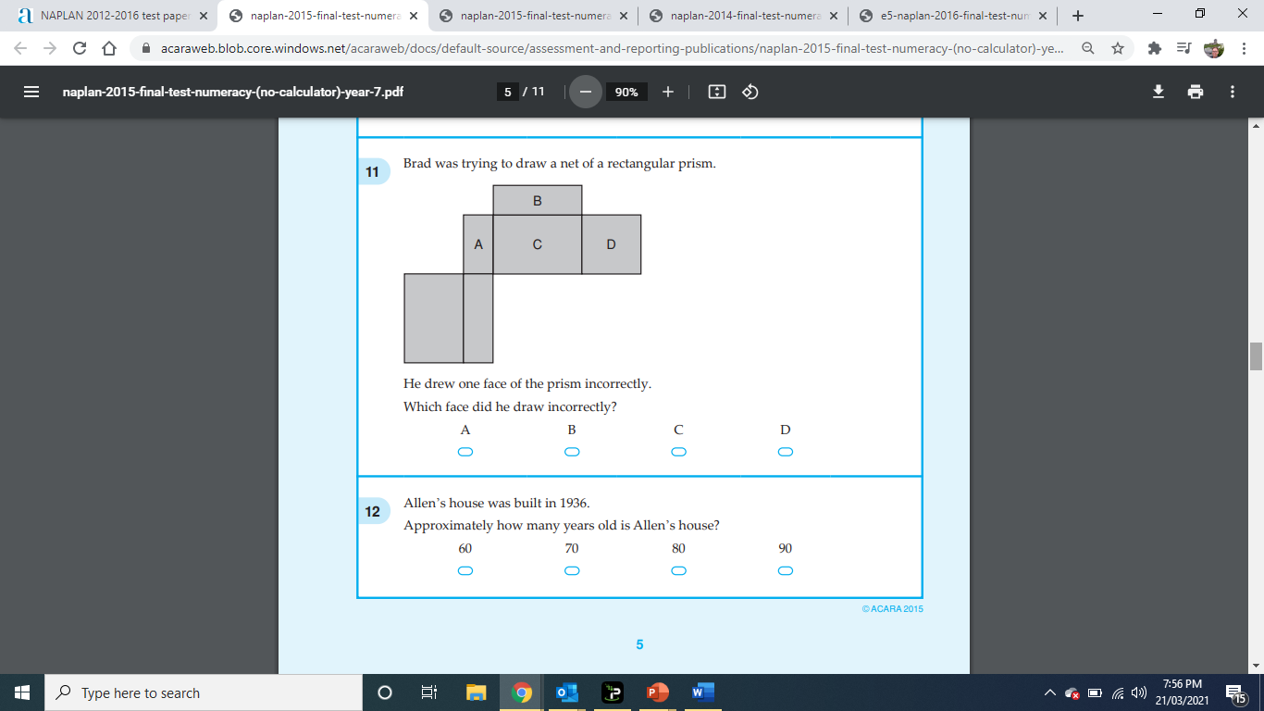
Lesson 15

Slide 48
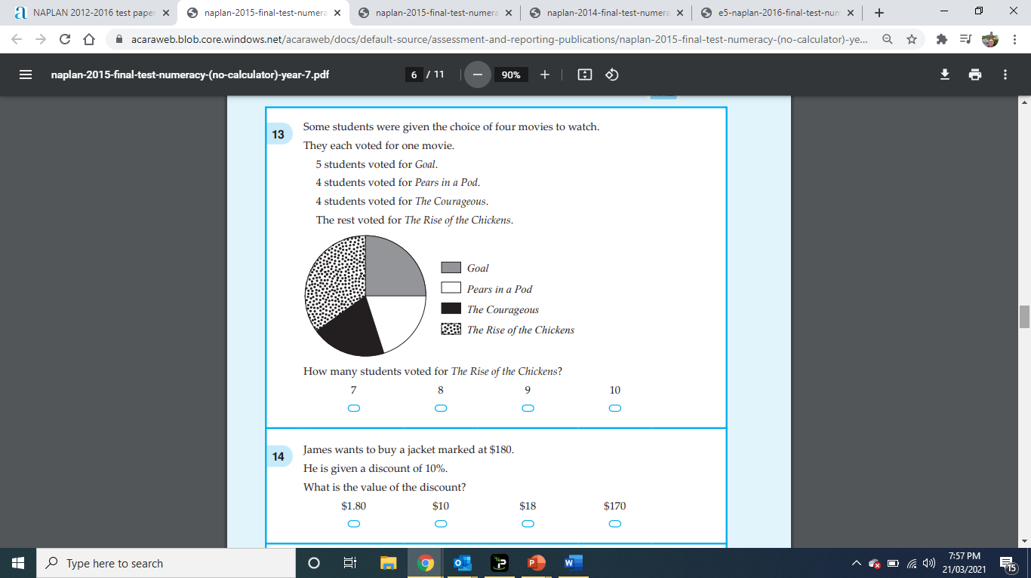
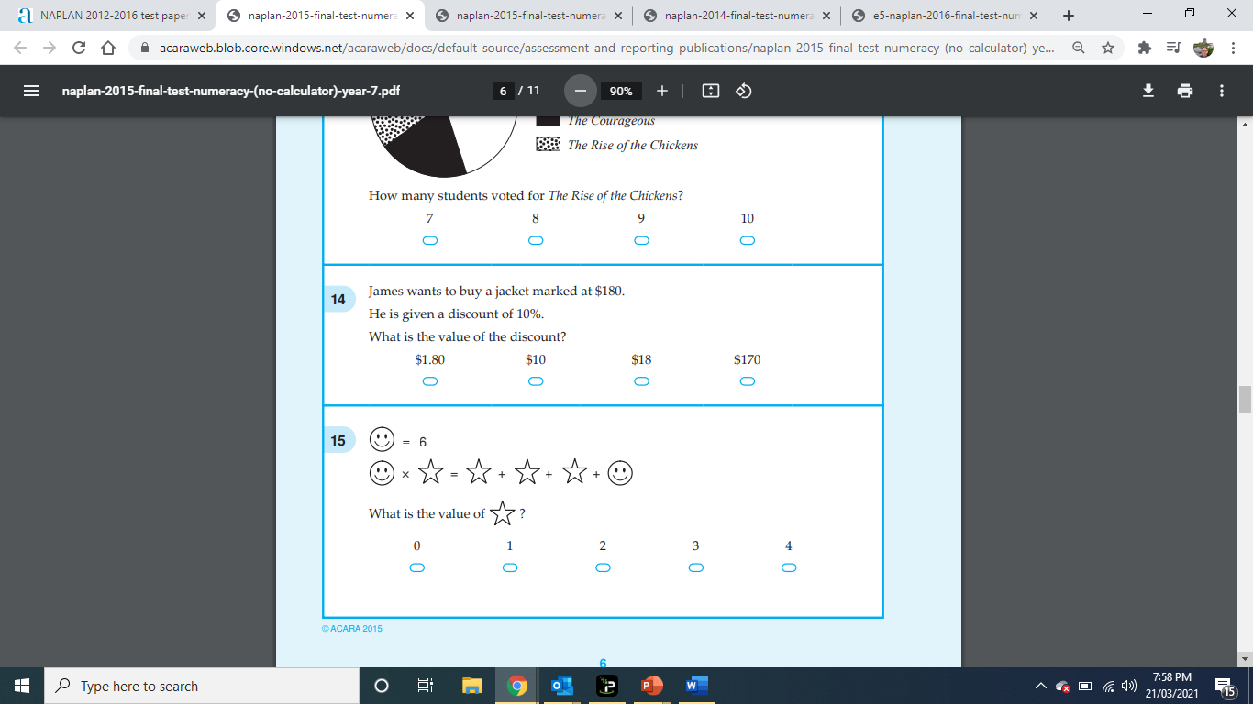
Lesson 15

Slide 49
LESSON SIXTEEN – NO CALCULATORS ALLOWED
NAPLAN 5 QUESTIONS STARTER

Slide 50
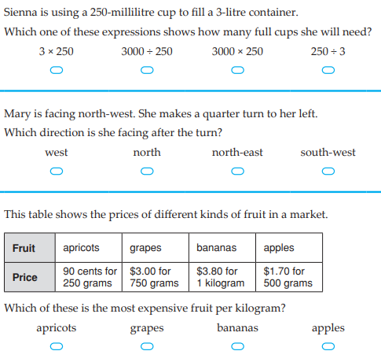
Lesson 15

Slide 51
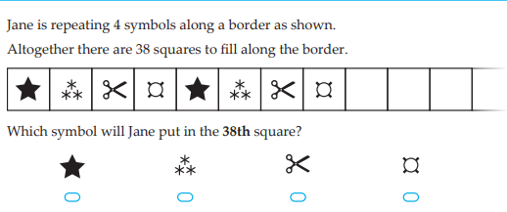
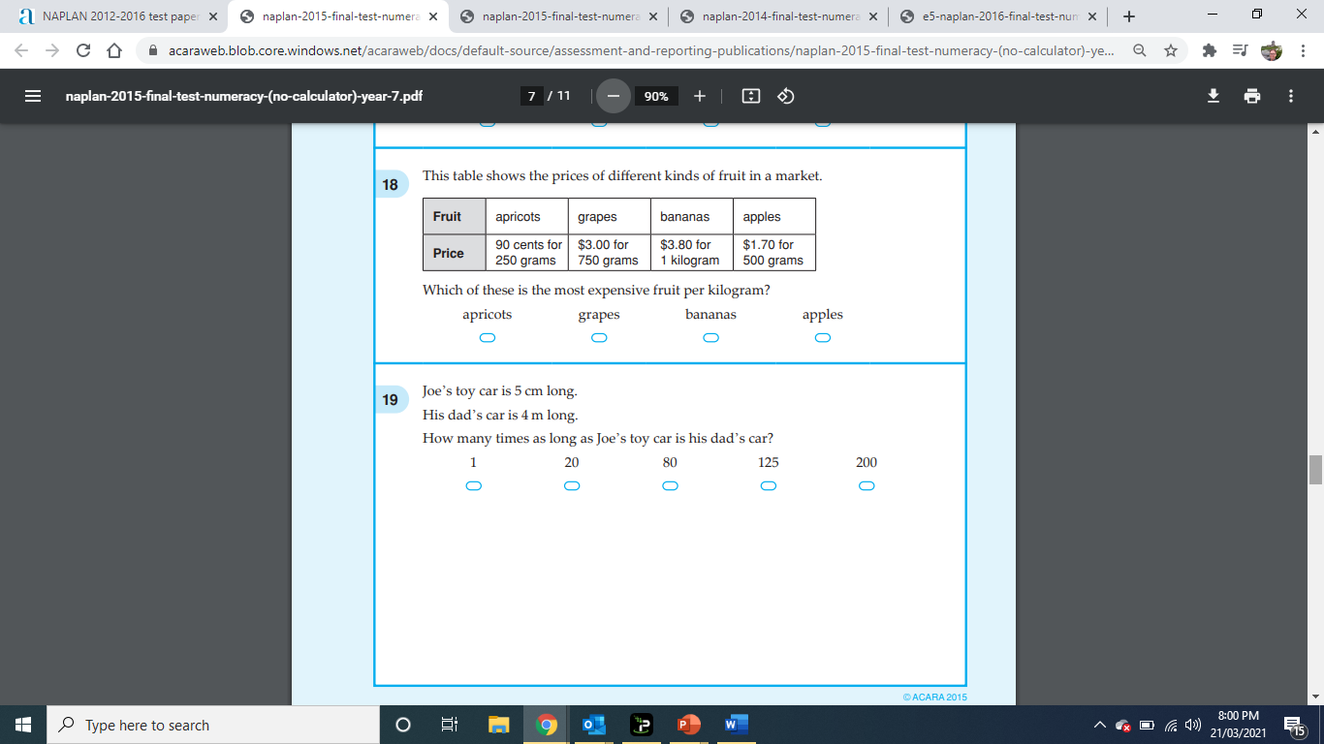
Lesson 15

Slide 52
LESSON SIXTEEN – NO CALCULATORS ALLOWED
NAPLAN 5 QUESTIONS STARTER

Slide 53
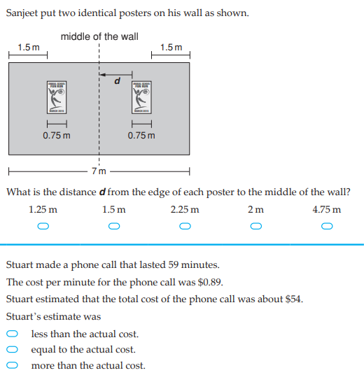
Lesson 16

Slide 54
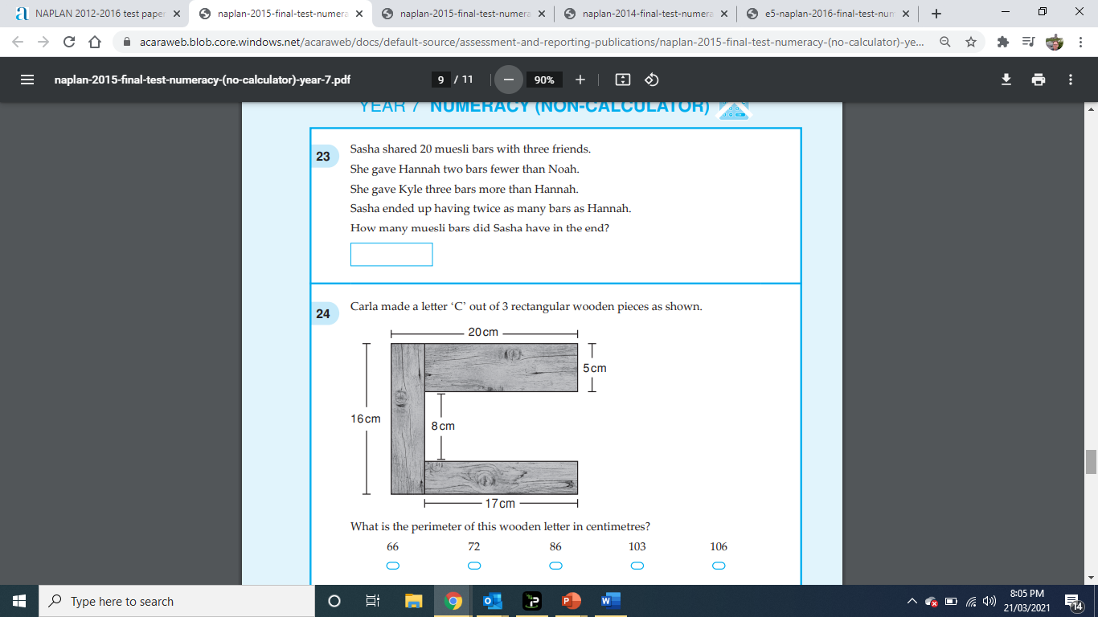
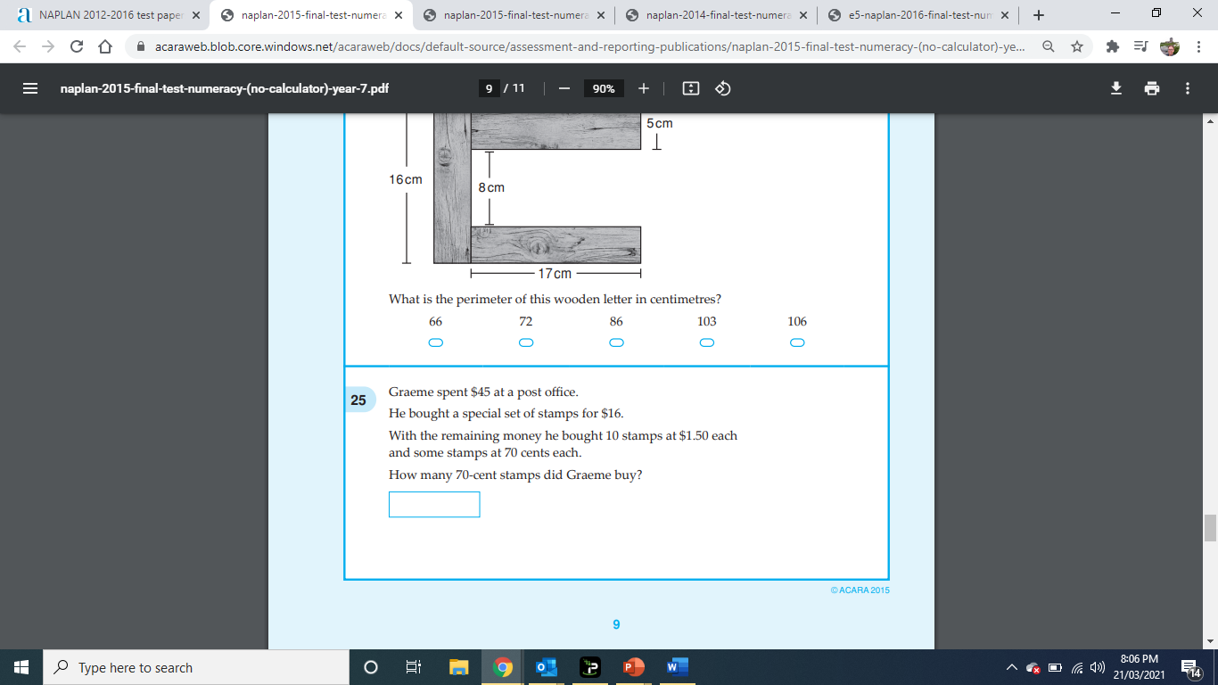
Lesson 16

Slide 55
LESSON SEVENTEEN – NO CALCULATORS ALLOWED
NAPLAN 5 QUESTIONS STARTER

Slide 56


Lesson 17

Slide 57

Lesson 17

Slide 58
LESSON EIGHTTEEN – CALCULATORS ALLOWED
NAPLAN 5 QUESTIONS STARTER

Slide 59


Lesson 18

Slide 60


Lesson 18

Slide 61
LESSON NINETEEN – CALCULATORS ALLOWED
NAPLAN 5 QUESTIONS STARTER

Slide 62

Lesson 19

Slide 63


Lesson 19

Slide 64
LESSON TWENTY – CALCULATORS ALLOWED
NAPLAN 5 QUESTIONS STARTER

Slide 65


Lesson 20

Slide 66


Lesson 20

